Slide 1
Afghanistan --- an overview: Physical, Cultural, and Political

Slide 2
Afghanistan has had a long history of conflict including:
2 wars with the UK in 1800
Invasion by the Soviet Union in 1979
When the USSR left in 1989 Afghanistan has experienced infighting over control of the country

Slide 3
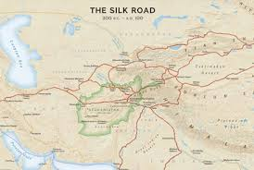
A crossroads and buffer state
Afghanistan is:
Caught between neighboring states
Crossroads on ancient trade routes
Buffer between differing religions

Slide 4
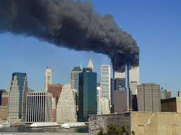
American interest began with:
Terrorist attack on the World Trade Centre (9/11)
Osama Bun Laden was identified as the leader of a terrorist organization with headquarters Afghanistan that planned the attack

Slide 5
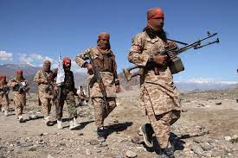
Background
In 1996 a group named the Taliban took control of Afghanistan. They were accused of supporting the terrorist the attacked the world trade center.
The U.S. military started conducting air strikes on the Taliban facilities in Afghanistan began on October, 7, 2001

Slide 6
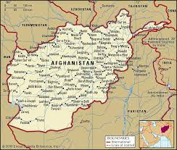
Afghanistan in spatial terms
Afghanistan in spatial terms
Absolute location: 33N, 65 E
Relative location: landlocked in south Asia
Neighbors: N and W Pakistan, east of Iran, South of Turkmenistan, Uzbekistan, and Tajikistan

Slide 7
Physical systems
Topography
Afghanistan is mainly mountainous with steep isolated valleys the Hindu Kush mountains extend northeast to southwest through Afghanistan. The Paropamisus Mountains lie in the northwest. Several peaks rise above 20,000 fee
Afghanistan has a wide array of natural features including deserts plains and fertile valleys. The country has 3 main land regions:
The northern plains is the northernmost region in Afghanistan
The central highland covers 2/3 of the country. This region contains the Hindu Kush. Most people live in the valleys in the Hindu Kush
The Southwest Lowlands mainly consists of deserts

Slide 8
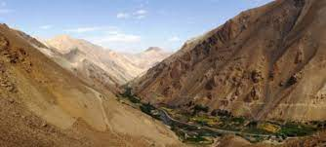
Climate
Afghanistan has a harsh continental climate. Harsh winters are amplified by high elevation. Summers are warm except in the highest elevation. Much of the country is arid or semi-arid. Precipitation is light, falling mostly in winter and spring almost none from June to October

